Slide 1
Mouse cursor control via body motion data
Biomedical final project
Aurora Bertino, Chiara Saporetti,
Gabriele Reverberi, Sara Romano

Slide 2
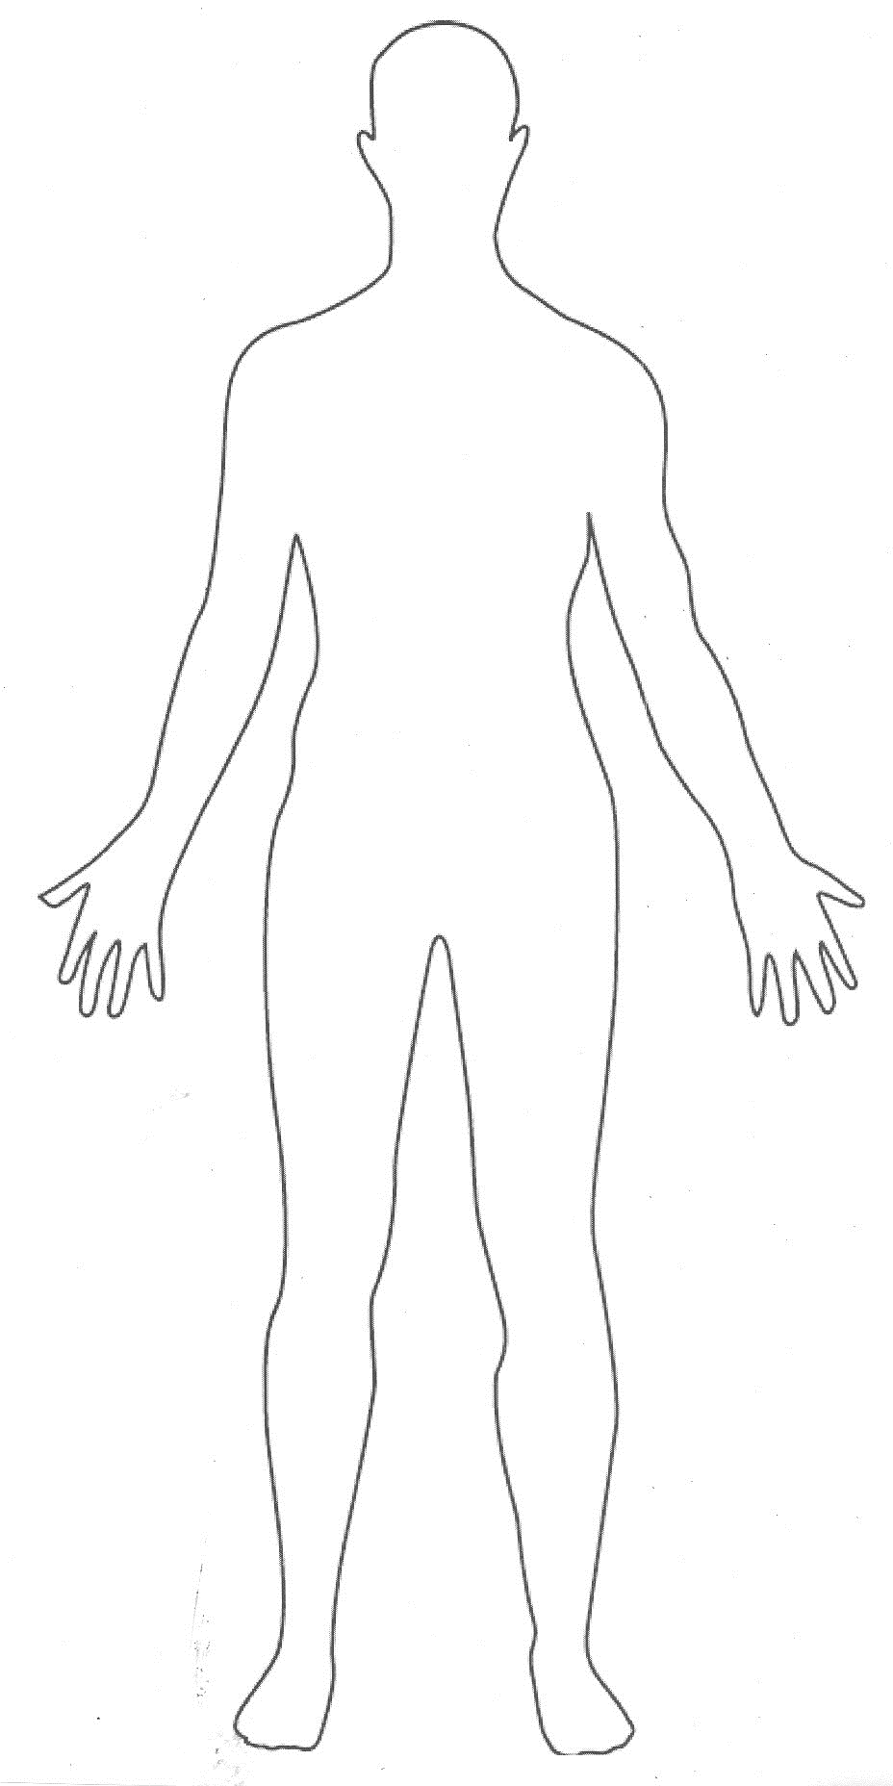
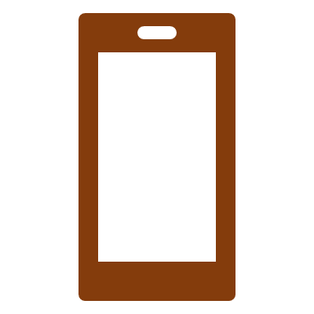


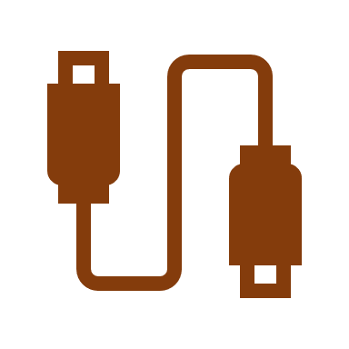
Introduction
Goal: make a mapping from the motion data extracted from the gyroscope of a smartphone to the motion of a computer’s cursor.
Main focuses: helping people with rehabilitation and providing computer access for people with mild to severe disabilities.
HardWare:
Computer ASUS VivoBook
Android smartphone Huawei P30
USB cable to connect the device to the computer.
SoftWare: Matlab 2020b + ‘’Hardware package for Android’’ add-on.

Slide 3
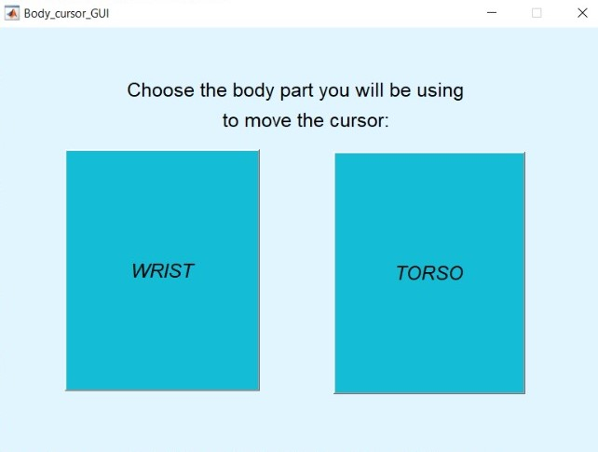
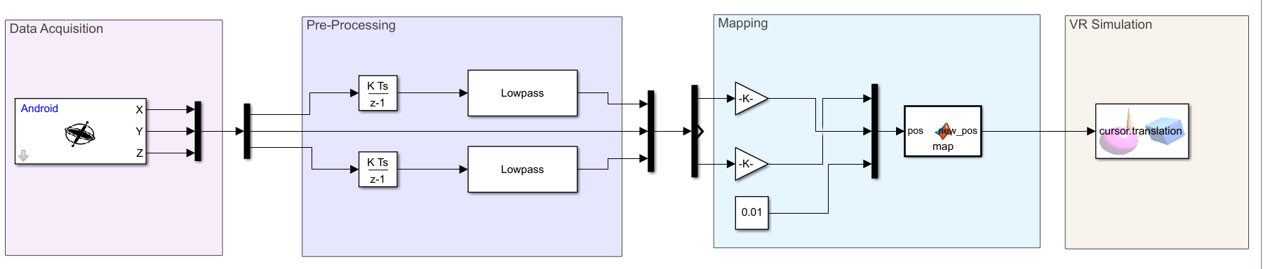
Simulink model
Notes:
The work environment starts with a GUI (graphic user interface ) which gives the user the possibility to choose between two different setup : wrist and torso.
In particular the decision of using the torso inclination came from the wish to guarantee a stable control of the cursor to several categories of amputees. Fixing a smartphone on the chest is easy, stable and provides a clean control by simply using the indivudual balance.
And this is a complete overview of how the Simulink model is implemented : It is constituted by 4 major blocks : the acquisition, which contains the sensory data input block, the pre-processing part, which deals with signal integration and filtering, the mapping section, which regulates the response of the mobile phone signal in accordance with the simulation, and finally the VR block, which contains a simple 2D animation constituted by 8 coloured target dots, a white cursor and a red center marker.

Slide 4
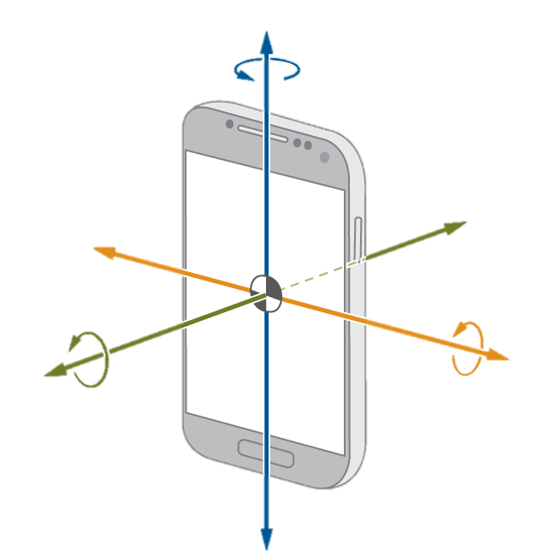
y
Smartphone sensors
Accelerometer
Orientation
Gyroscope
Why the gyroscope?
Initialization
One integration only
z
x
Measuring
Integration, filtering
Range of motion
Mapping
Simulating
Notes:
During the project implementation, we took into consideration some of the direct motion sensors that an average android smatphone could provide : Accelerometer, orientation and gyroscope. The most convenient choice resulted to be the gyroscope for two main resaons: the first: all the other sesors take into account the gravitational acceleration and in some cases also the signal coming from the embedded magnetometer. This requires an additional initialization step to separate the acceleration components and of course the sensors are unpredictably affected by magnets and metallic objects around the device. The second: as long as the gyroscope measures the angular velocity of the device, only one integrator is needed.

Slide 5
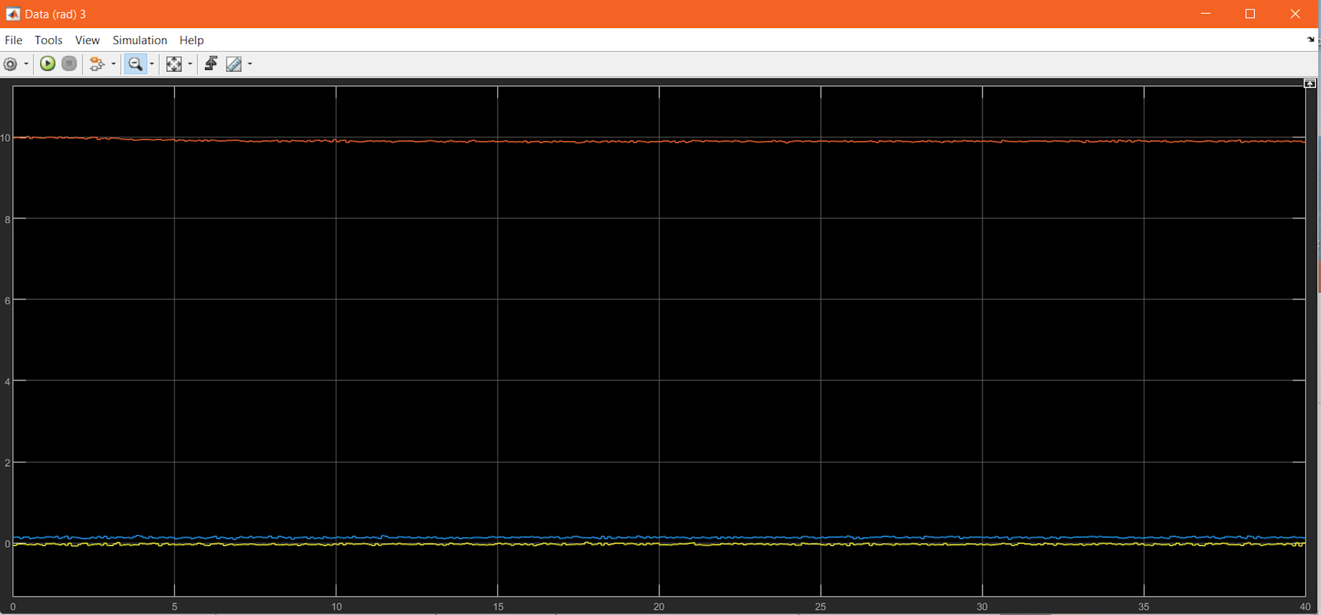
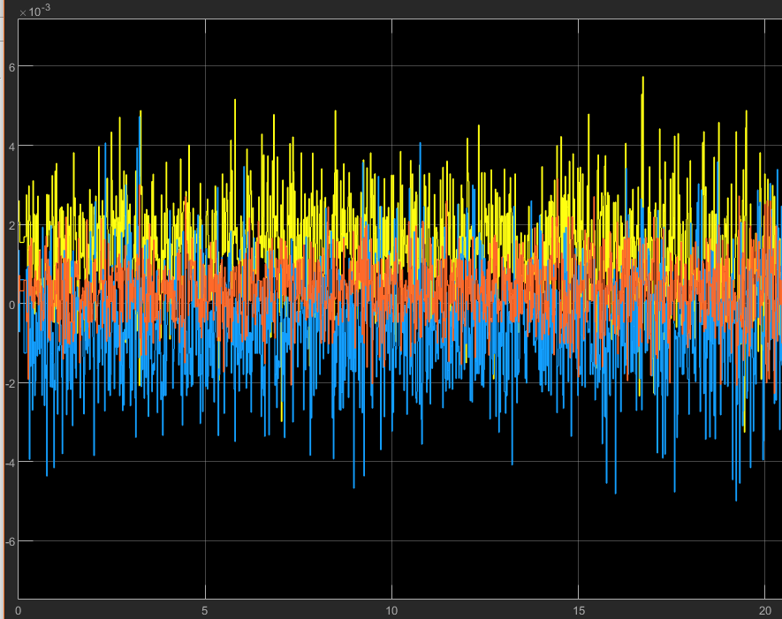
Accelerometer
Gyroscope
Measuring
Integration, filtering
Range of motion
Mapping
Simulating
Notes:
During the project implementation, we took into consideration some of the direct motion sensors that an average android smatphone could provide : Accelerometer, orientation and gyroscope. The most convenient choice resulted to be the gyroscope for two main resaons: the first: all the other sesors take into account the gravitational acceleration and in some cases also the signal coming from the embedded magnetometer. This requires an additional initialization step to separate the acceleration components and of course the sensors are unpredictably affected by magnets and metallic objects around the device. The second: as long as the gyroscope measures the angular velocity of the device, only one integrator is needed.

Slide 6
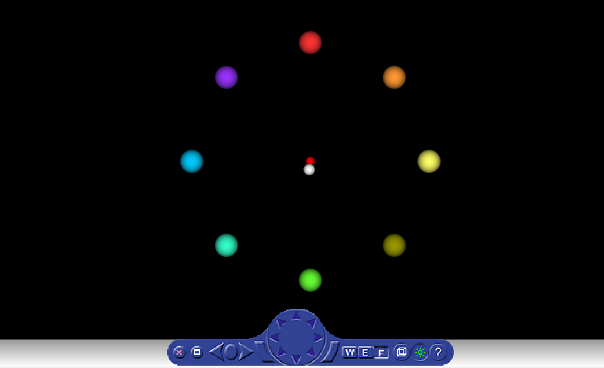
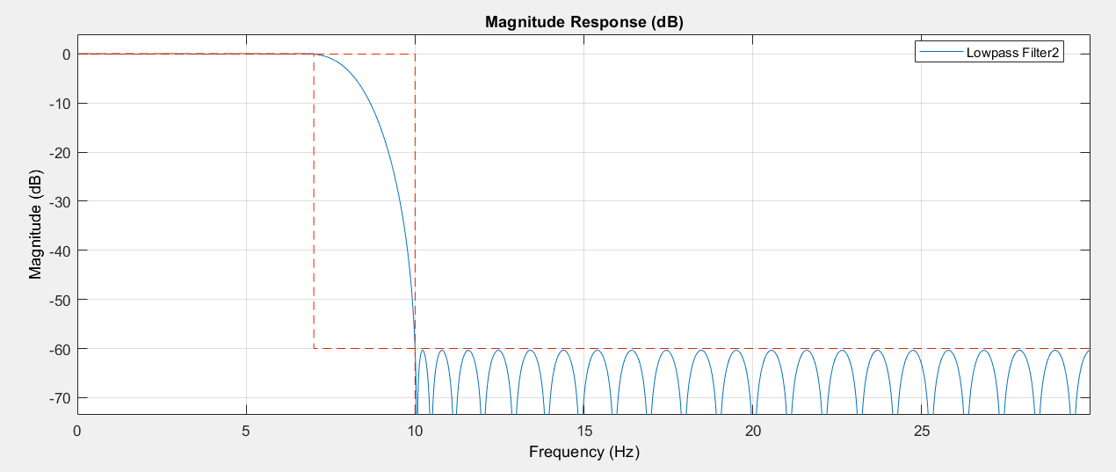
Low pass filter:
• Passband Ripple = 0,1 dB
• Passband edge frequency = 7 Hz
• Stopband Edge Frequency = 10 Hz
• Stopband Attenuation = 60 dB
• Input Sample rate = 60 Hz
Measuring
Integration, filtering
Range of motion
Mapping
Simulating
Notes:
As said before, the first step to properly use the gyroscope signal is to integrate it, this is done by simply using the MatLab discrete time integrator block. The primary analisys of the unfiltered signal also enlighted an idle disturbance occurring with a 60 Hz frequency (which is the sampling frequency we decided to use for the data acquisition). To overcome the effect of this disurbance and mitigate spurious oscillations of the device during the motion caused by physiological instability of the body, a lowpass filter is implemented. Setting parameters of the filter are shown in this slide. The filter response is a simulation of a physical filter, so the parameters we had to set included a passband ripple which we kept to the standard Matlab value and that could –should be modified in the case of a non- simulated electronic implementation .
The setting also required a reasonable evaluation of the stopband ripple which cannot be directly set, but depends on the passband frequency, on the stopband frequency and on the attenuation
We considered 60 dB to be a wise choice for the attenuation, as long as it guarantees a cut-off of all the spurious signals from several devices took into consideration during testing . As it might result obvious, the imput sample rate has been chosen to be 60 Hz,, the same frequency of the unfiltered signal displayed before.

Slide 7
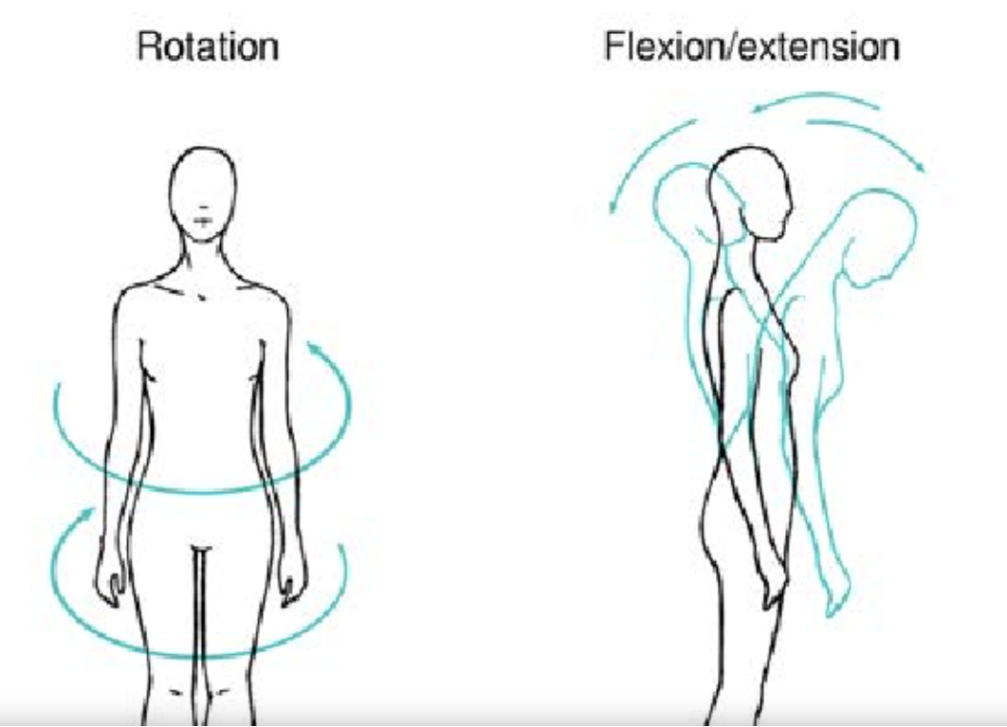
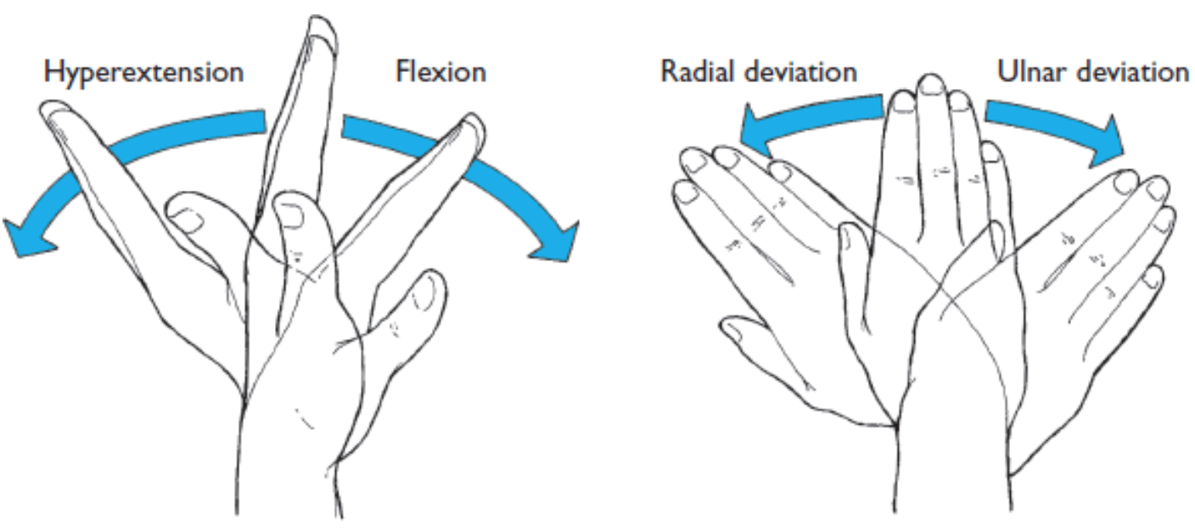


K1
Torso: [-20,+20]
Wrist: [-60,+60]
$$0.34 K1 = 0.1$$
$$→K1=0.29$$
$$0.104 K2 = 0.1$$
$$→K2=0.096$$
Measuring
Integration, filtering
Range of motion
Mapping
Simulating
Notes:
As mentioned when talking about the GUI, the experiment refers to 2 different usages of the device interface. We decided to concentrate on the movements of the wrist and the torso. Of course the available motion range of these two body parts is very different and each of them required a different calibration.. In particular the range chosen for the torso is from -20 to + 20 degrees and the one for the wrist from -60 to +60 derees. Both of the ranges are then scaled down to fit in the simulation environment.

Slide 8
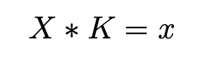
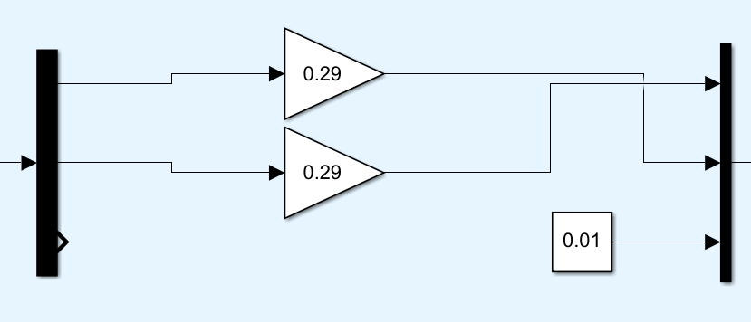
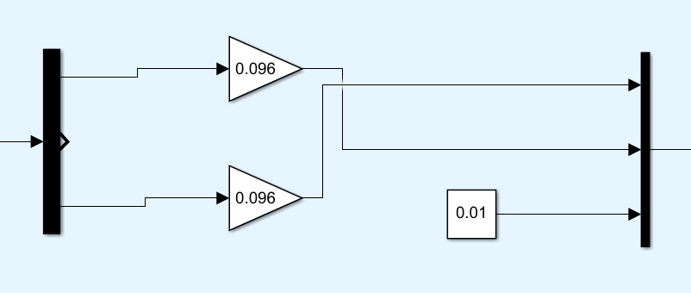
Generalized control rule
Range of motion Torso
Range of motion Wrist
-
-
Measuring
Integration, filtering
Range of motion
Mapping
Simulating

Slide 9
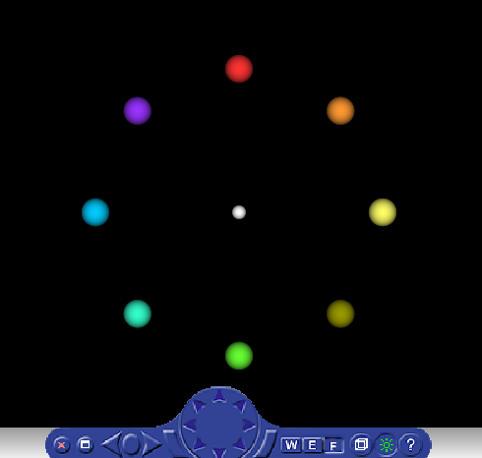
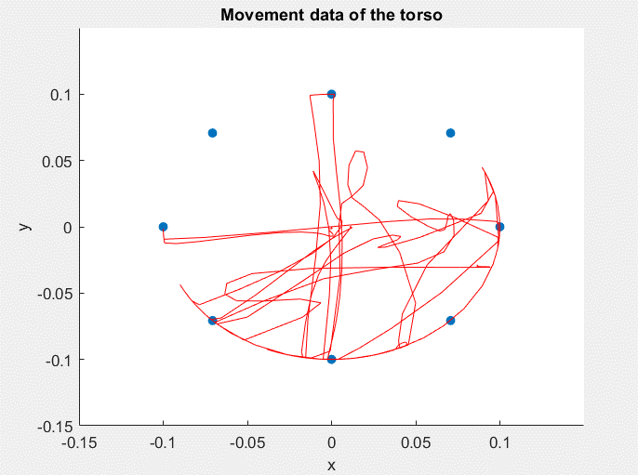
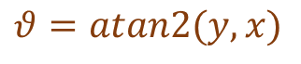


$$θ$$
$$θ=atan2(y,x)$$
$$\left\{\begin{aligned}x=0.1 cos⁡(θ) \\ y=0.1 sin(θ)\end{aligned}\right.$$
Measuring
Integration, filtering
Range of motion
Mapping
Simulating
Notes:
One further improvement of this project is to make the cursor move in a certain space thus by allowing the user to control the interface without going beyond the cirumference specified by the targets. To this aim we set some constraints to the final data position in case it falls outside of the circle. So, for example, consider the cursor position to be the red dot on the top right. (*) We have to compute the angle theta as the atan2 of the dot’s y and x. (*) Then we simply remap the position on the circle wrt the sin and cos of the angle. (*) In the end, all the positions that fall inside the circle are left as they are, the others are modified. The final result will be the one described by the plot that you see overimposed to the picture.

Slide 10
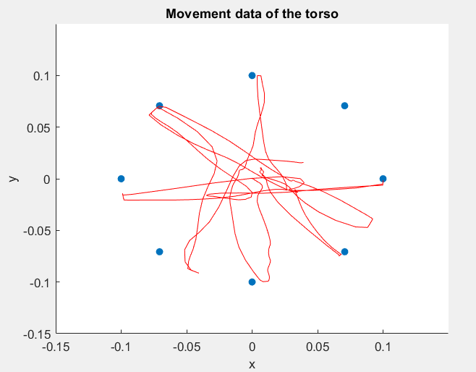
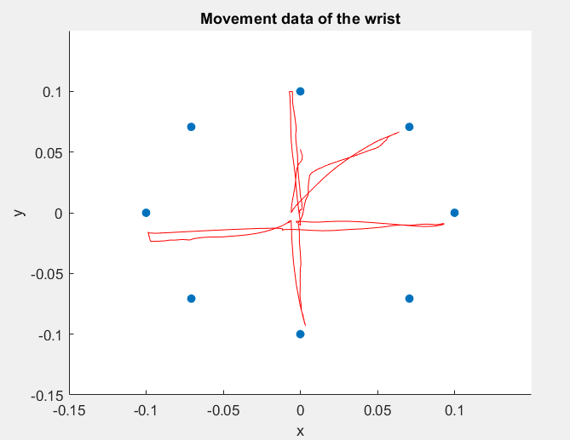
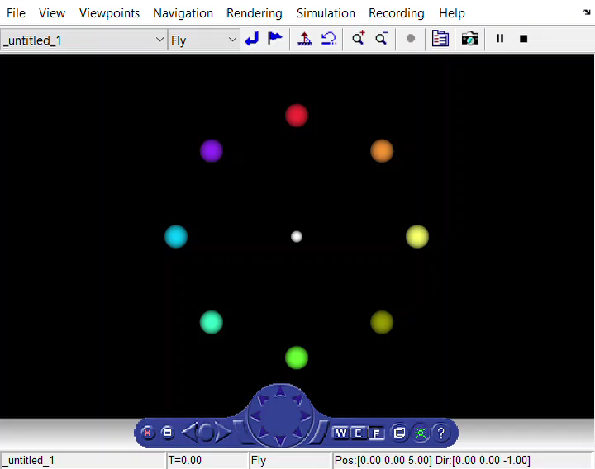
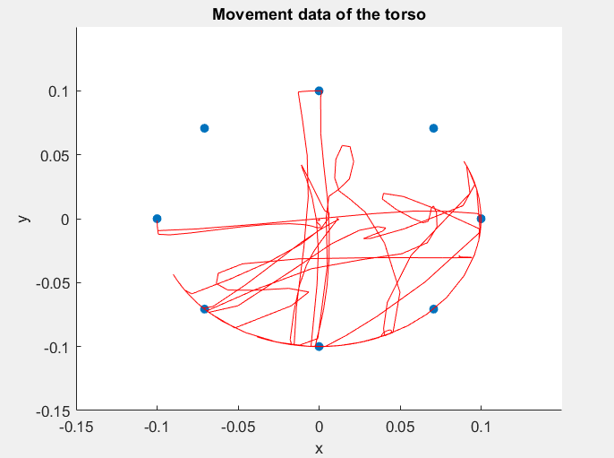
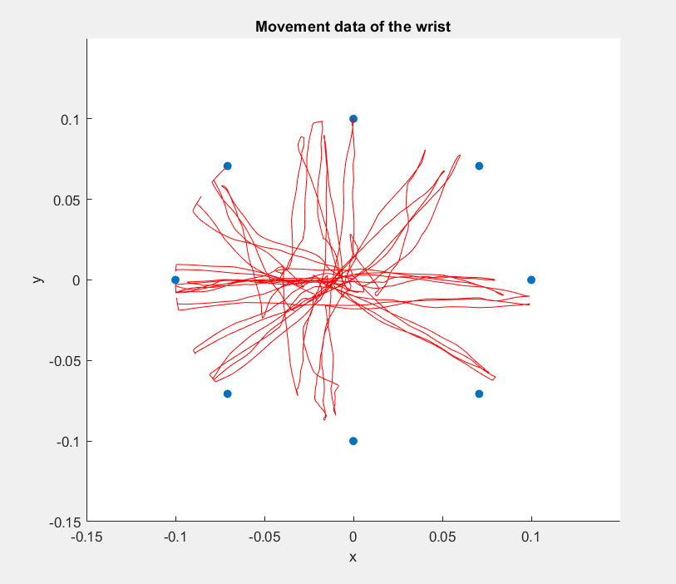
Results
video
Measuring
Integration, filtering
Range of motion
Mapping
Simulating
Notes:
In this slide we can see, at the center, a video of the cursor moving inside of the VR sink. These plots were made by modifying the code of the assignment zero we did at the beginning of the semester and adding the dots that represent the balls.
On the left, there are two examples of movements realized with the torso. The first is one of the very first ones we made, and in fact the movements are a little insecure, since we still needed to develop a certain confidence with the movements. While the second on the left is put there to show the mapping to the circle.
On the right there are two examples with the wrist: the first was again one of the first trials and was made by running the code for about a minute and a half, while the second was run for about 40 seconds and after a while that we had been practicing, in order to show the precision that can be reached.

Slide 11
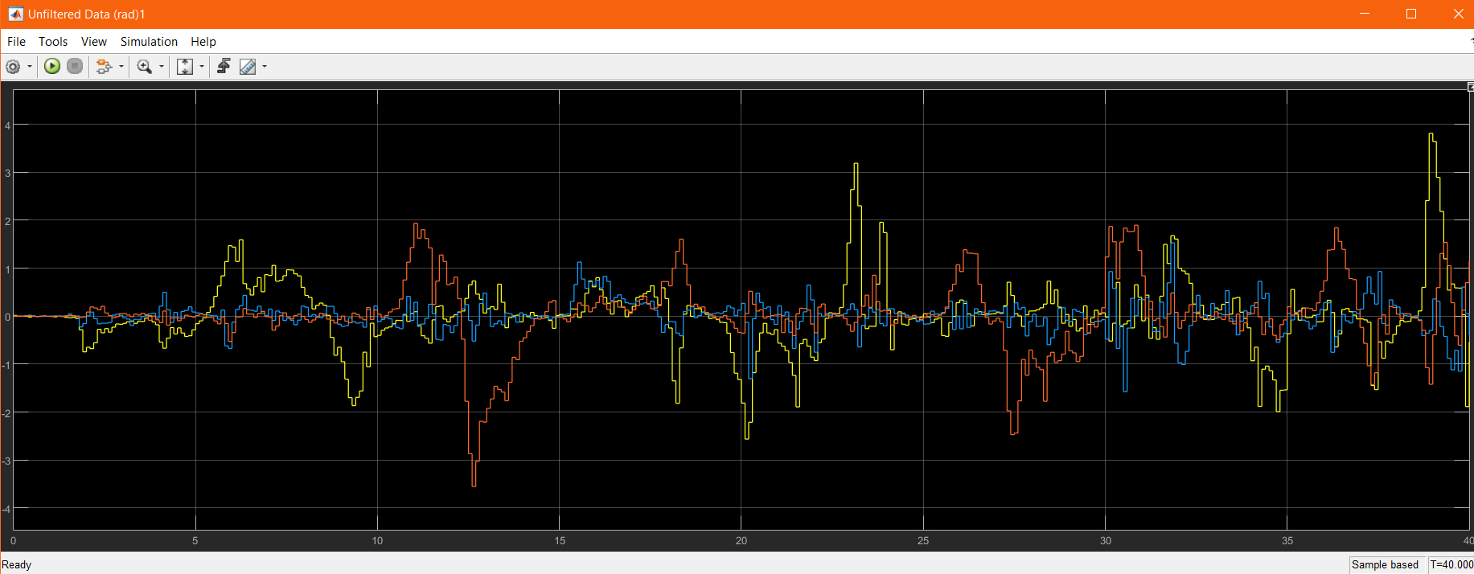
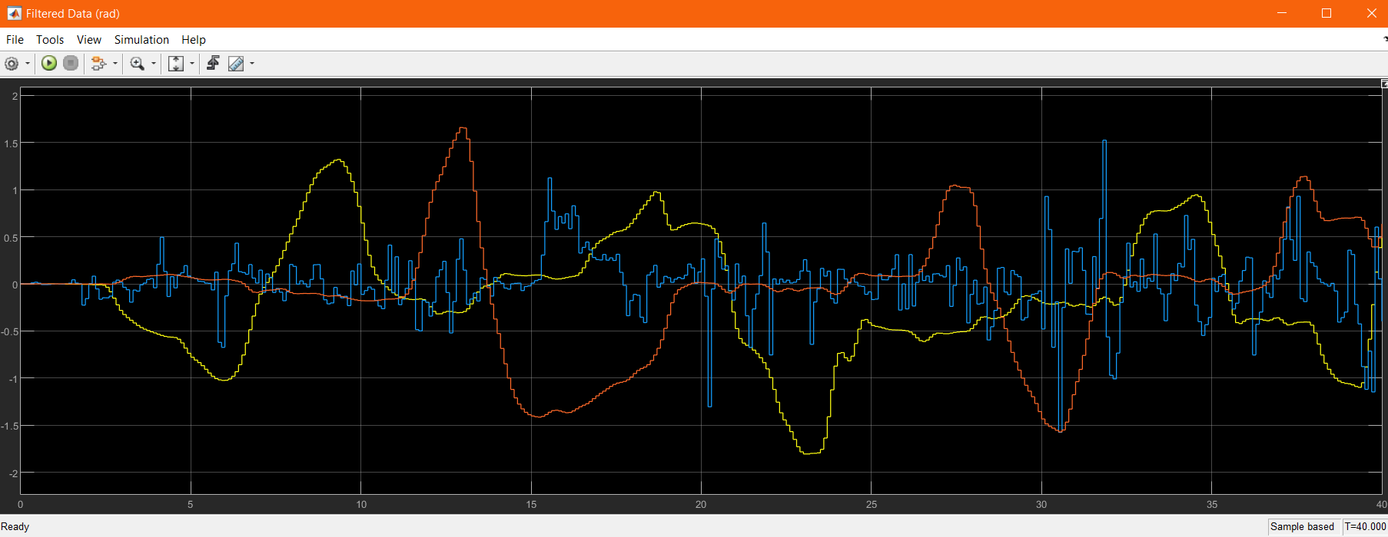
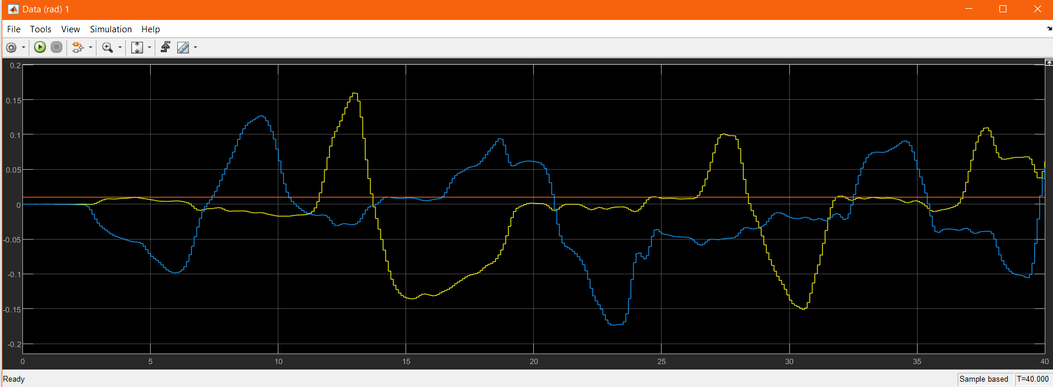
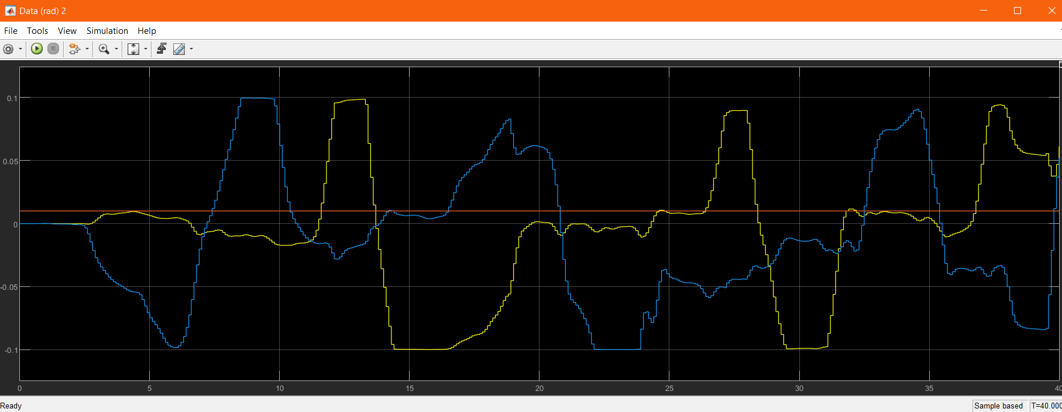
Results
x
y
z
x
y
z
Notes:
These instead are the plots of the x,y,z data as they get modified throughout the model. First there are the unfiltered data, then the data after the filtering. We kept the z for the plot, but it wasn’t necessary to filter it since it wasn’t used. On the bottom left the data was modified to enter in the right range of motion, but still could go a little bit outside of the circle, (*) while on the right we can see that the signal is cut at 0.1, and this is the final data that we give to VR sink as input.

Slide 12
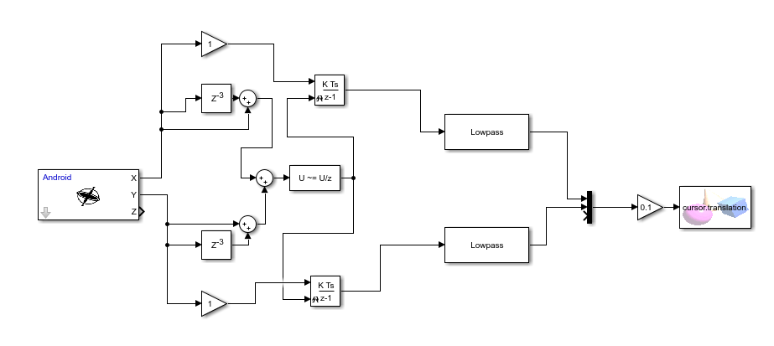
Limitations and further improvements
Recalibration: two possible approaches: either combining the gyroscope signal with the accelerometer or using an automatic reset during idle time.
Notes:
of course this project still has several limitations, for example: the gyroscope can detect changes in the rotation of the phone over the three axes. Each rotation measurement is based on the previous estimate (it is a relative measurement approach). And this means that there is an "initial drift" and, over time, errors will add up. This error also increases in case of small impacts on the device.
To find a solution for this, there are two possible approaches: one is combining the gyroscope with the accelerometer, which on the other hand leads to the initialization and magnetic field disturbance problems enlighted before,
The other is to have an automatic reset during idle time : we tried to implement such setup, but there still are several imperfections that need a more detailed development
As shown in this picture, the main idea is to take the unfiltered signal delayed and not delayed and send it to a comparison block which triggers the zero setting on the discrete integrator block every time .
In particular this setup seems to work very fine with a lower sampling frequency (10 hz) . We tried it with several android phones . Unfortunately we noticed that at a higher sampling rate, it doesn’t seem to work with all phones …..honestly … we took a lot of effort in this, but we still don’t know why …

Slide 13
Limitations and further improvements
GUI: add more body parts.
Exergame: improve the simulation to transform the project into a more engaging game for rehabilitation.
Notes:
after solving this problem (hopefully) we could also think to add more parts to the gui, of course adding more simulink blocks with ad-hoc modified parameters.
and in the end, also modifying the 3d environment to make it more eye-catchy can be a great improvement ! Imagine to be able to play a game which could also implement the individual’s balance by simply using the smartphone… or why not.. A vr headset ! !

